Slide 1


Audio Interface with Camera (AIC)
Group 25
Principle of Professional Practice

Slide 2
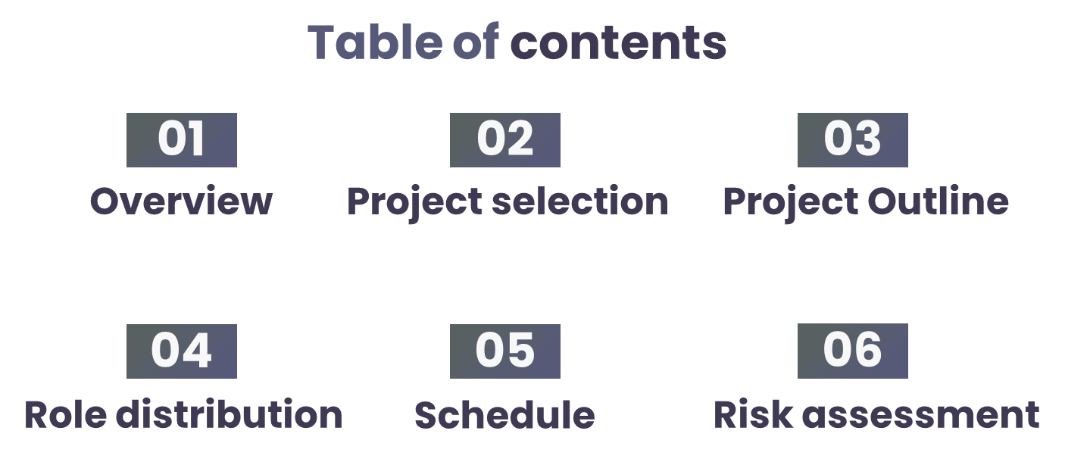
(Kevin Wang)
(Siraj Salih)
(Your name)
(Dheeraj Polanki)
(Wan Zaqeem)
(Yichen Zhang)

Slide 3

01
Overview

Slide 4
What is Audio Interface with Camera (AIC)
Introducing an innovative audio interface with an integrated camera designed specifically to assist blind and visually impaired individuals in navigating through streets and public spaces. The idea of the project is to combine advanced technology and user-friendly features to enhance mobility and independence for those with vision challenges.

Slide 5
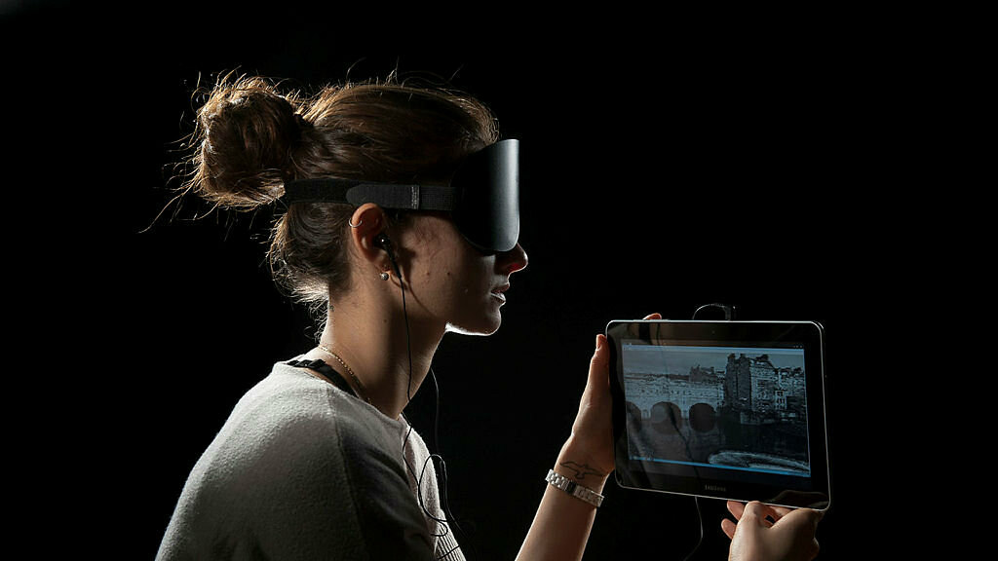
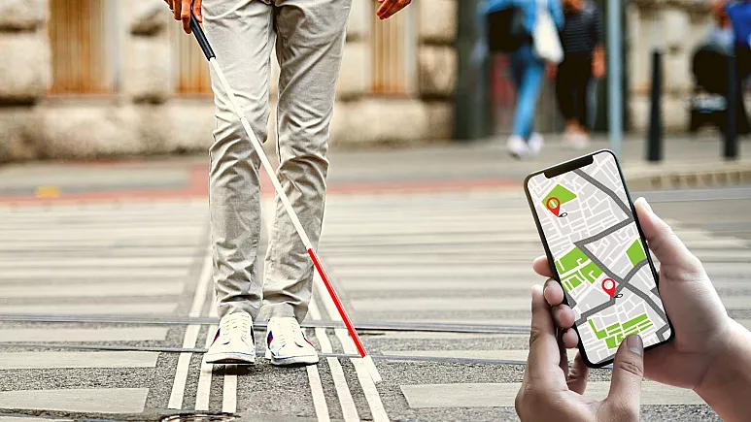
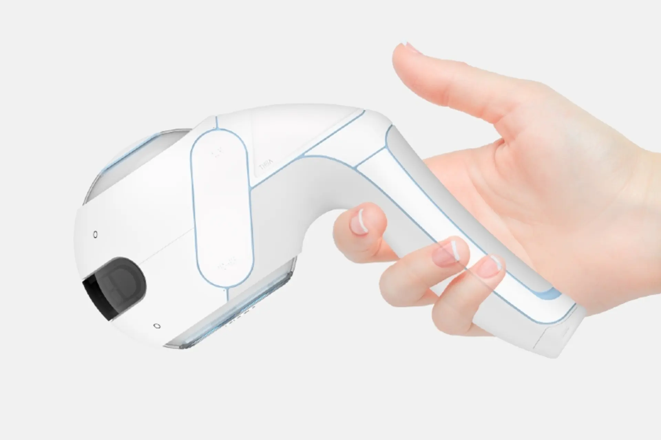
Existing Projects
The vOICe’ | 3D sound map | Handheld robotic guide dog
Soundscape headset that allows blind people to ‘see’ the world. The system uses a visor camera to convert images into intricate "soundscapes," which are then transmitted to the user through headphones. | An AR navigation app that can guild the blind in the right direction. It is like a ‘complement’ to the hardware device or guide dog. | Uses sensors, cameras, and algorithms to detect obstacles and provide real-time feedback to blind people through audio signals (voice recognition).

Slide 6

02
Project Selection

Slide 7
Our criteria for the Research Project
The project must be completed in 24 weeks.
Feasible within limited budget and possible to conduct. throughout the university study program.
The safety of the participants must be guaranteed through the project.
It must be environmental friendly and contributes to the disabled community.
Accessibility

Slide 8
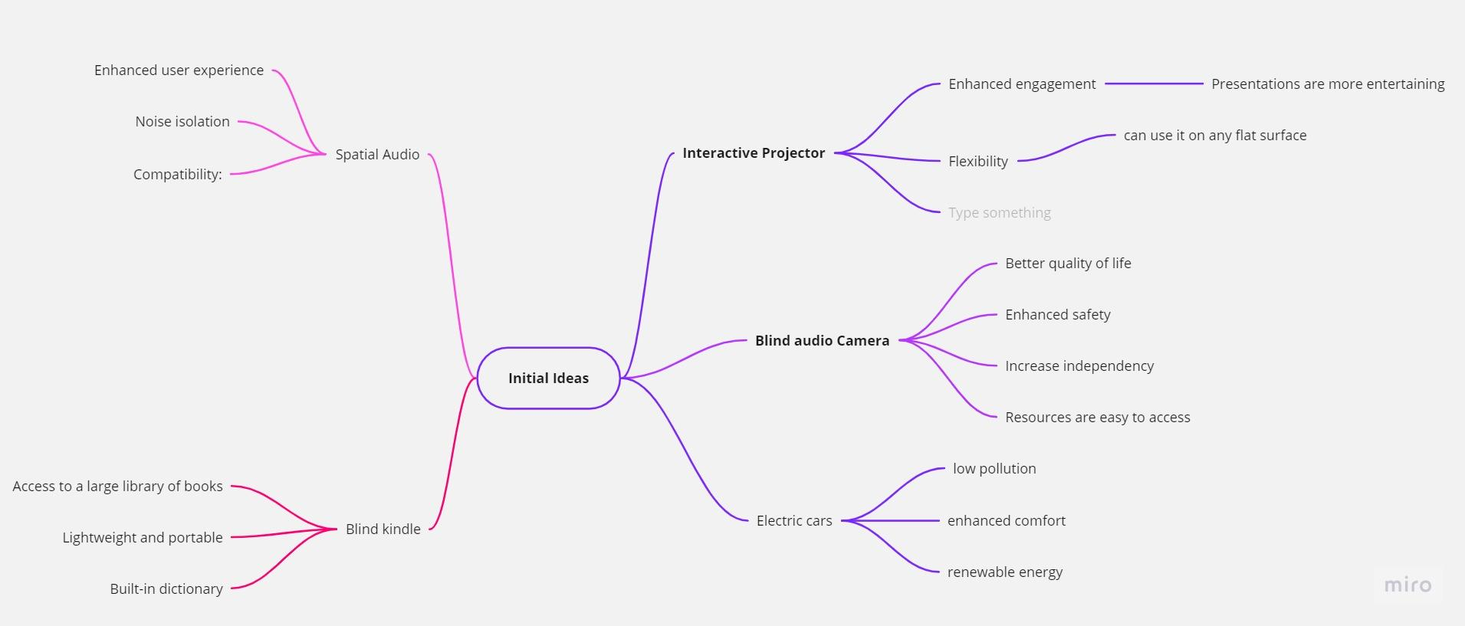
NETWORK OF INITIAL IDEAS

Slide 9
RANKING CRITERIA IN ORDER OF PRIORITY
Criteria |  | A | B | C | D | E
24 weeks to complete | A |  | B | A | D | A
Feasibility (budget & resource) | B |  |  | B | BD | E
Safety ( participants & protocols ) | C |  |  |  | D | C
Impact on society and environment | D |  |  |  |  | D
Accessibility | E
TOTAL A = 2, B = 2.5, C = 1, D = 3.5, E = 1

Slide 10
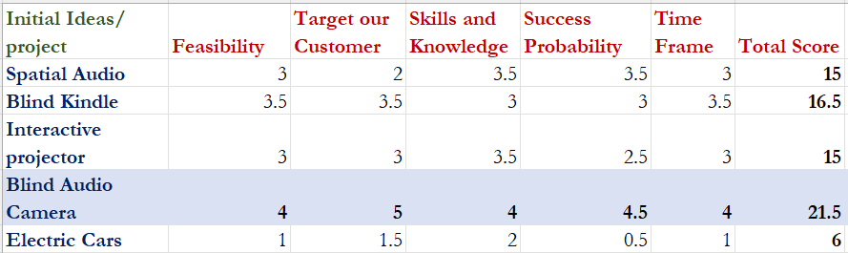
Choosing The Correct Idea

Slide 11
SELECTION OF DESIGN
DESIGN A | DESIGN B | DESIGN C
Sensors With mobile phone LIDAR Application feature | Image processing With mobile phone No LIDAR Built-in software | Without mobile phone Image processing - NO LIDAR Built-in software

Slide 12
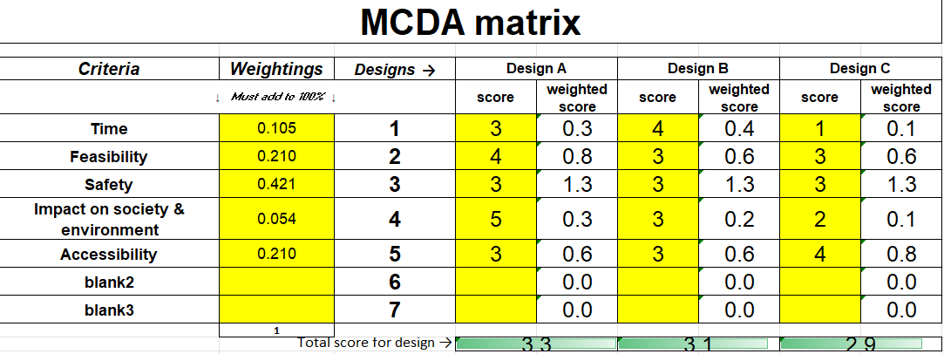
MCDA matrix for different designs

Slide 13

03
Project Outline
Notes:
We may add the tools and standard we need to meet in this section.(apart from the general outline of out project)

Slide 14
Project Outline
1
2
Design
Software
Receive data
Algorithms to analyse the environment
Distance detection
Output audio
Bluetooth Integration
Background research
Hardware
Select components
3D Model
PCB board
Customer research
Current technologies
Programming languages and frameworks
Develop project plan and timeline
Identify potential funding sources

Slide 15
Project Outline
3
4
Development
Testing & Documentation
3D print the case
Assemble the prototype
Integrate hardware and software
Test the prototype
Reliability and safety testing
Analyse result for reflection
Compile the results and reflection in a prototype report.

Slide 16
Resource requirements
Software Design
Hardware Design
Electronics lab
C++
Code Composer Studio
Matlab
Python
CAD
Vivado / modelsim
Altium Designer (PCB)
General lab

Slide 17
04
Role distribution

Slide 18
Role distribution
Social-oriented roles
Action- oriented roles
Thinking roles
Project Manager
Health and Safety
Resource Investigator
Software Developer
Hardware Developer
Research Analyst

Slide 19
Role distribution
Yichen Zhang
Wan Zaqeem
Siraj Salih
Project Manager
Resource Investigator
Safety Engineer
Dheeraj Polanki
Kevin Wang
Isaac Omar
Hardware Developer
Software Developer
Research Analyst

Slide 20
Roles | Job Description | Justification
Project Manager (Yichen Zhang) | Defining project objectives Developing a project plan Managing resources Monitoring progress | Rich experience being a team leader. Excellent leadership and time management skills
Resource Investigator (Wan Zaqeem) | Identify potential resources Identify potential organizations that can sponsor. Create and maintain relationships with sponsors and resource providers | Expert in doing research and analytical thinking with excellent communication skills. Able to reach out to potential partners or collaborators.
Software Developer (Kevin Wang) | Design and develop software Analyze and improve software performance | Specialise in audio processing algorithms Familiar with user interface design

Slide 21
Roles | Job Description | Justification
Hardware Developer (Dheeraj Polanki) | Create and review hardware schematics and layout designs Design and develop hardware solutions Prototype, test, and validate hardware designs | Strong understanding of VHDL and familiar with Vivado Good problem-solving skills Attention to details
Health and Safety Lead (Siraj Salih) | Conducting a risk assessment Developing a safety plan Ensuring compliance with safety regulations | Experience in electrical maintenance workshop Great collaborative skills Can quickly adapt to any work environments
Research Analyst (Isaac Omar) | Conduct surveys Analyse the data from the surveys Suggest recommendations based on the analysis of the surveys | Good analytical skills. Comfortable with communicating with various members for survey purpose

Slide 22
05
Project Schedule

Slide 23
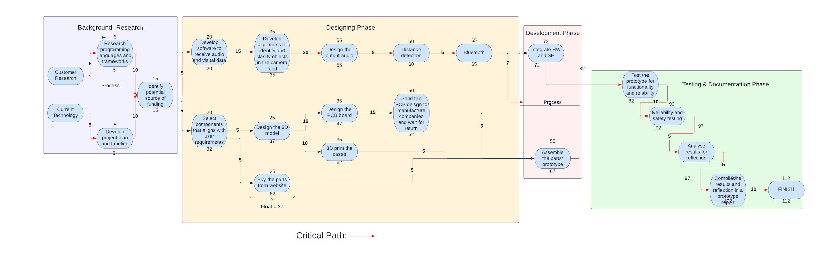
Network diagram

Slide 24
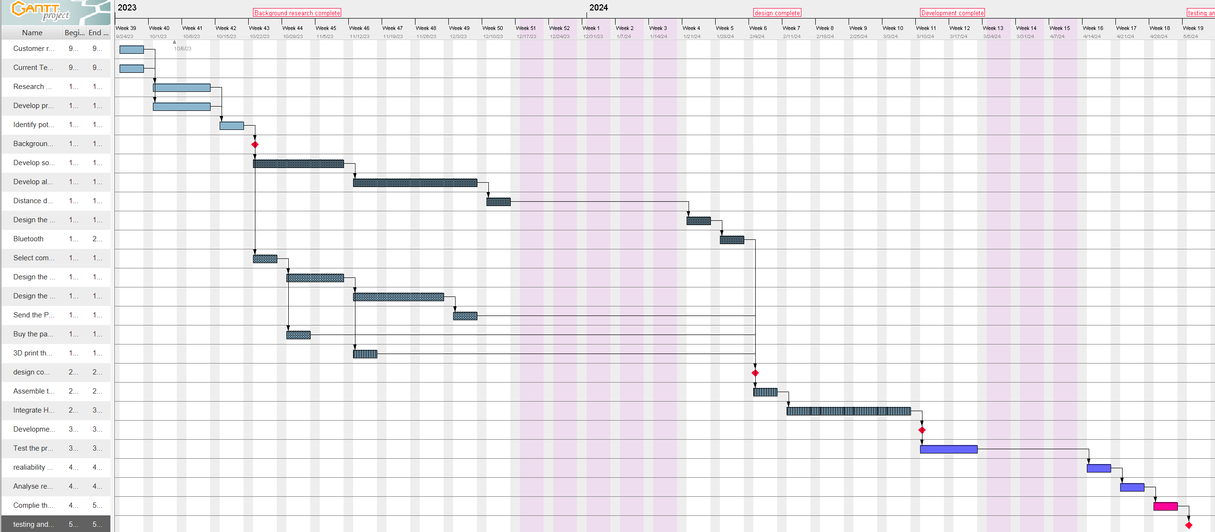
Gantt chart for workflow

Slide 25
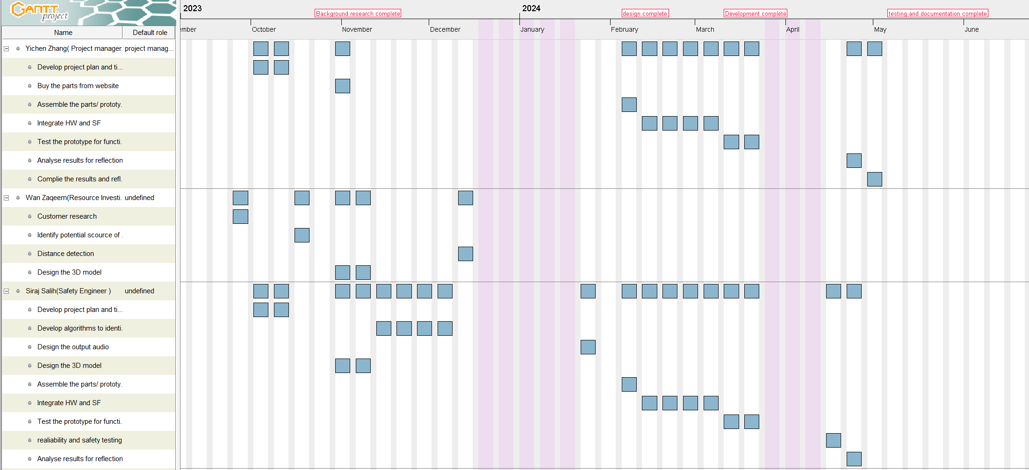
Resource Chart

Slide 26
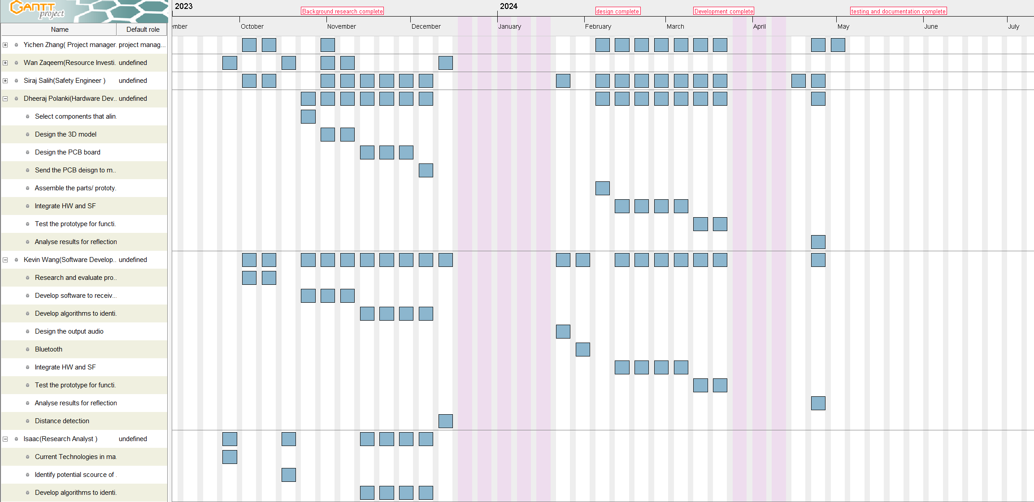
Resource Chart

Slide 27
06
Risk Assessment

Slide 28
Our Risk Assessment Criteria
 |  |  | Consequence
 |  |  | 1 | 2 | 3 | 4 | 5
 |  |  | Minimal | Minor | Moderate | Major | Catastrophic
Frequency | 5 | Almost certain | 5 | 10 | 15 | 20 | 25
 | 4 | Likely | 4 | 8 | 12 | 16 | 20
 | 3 | Possible | 3 | 6 | 9 | 12 | 15
 | 2 | Unlikely | 2 | 4 | 6 | 8 | 10
 | 1 | Highly unlikely | 1 | 2 | 3 | 4 | 5
Frequency Definitions
Almost certain | Happens every time in work process.-- equivalent to twice in a week.
Likely | Happens every six work days. --equivalent to once in two weeks
Possible | Once a month
Unlikely | 1%of the time. -- equivalent to once in six months
Highly unlikely | 0.1% of the time. Hardly going to happen during the project
Consequence Definitions
Catastrophic | Cancellation of the project and loss of all fundings. Serious damage to members.
Major | One month of project delay. Loss of main fundings. Damage to members.
Moderate | One week of delay. Loss of half fundings. Small injury to members.
Minor | 2-3 days of delay. Loss of minor fundings. No significant injury.
Insignificant | No delay, loss of fundings less than 10 pounds. No injury at all.
Notes:
The risk assessment criteria for our project

Slide 29
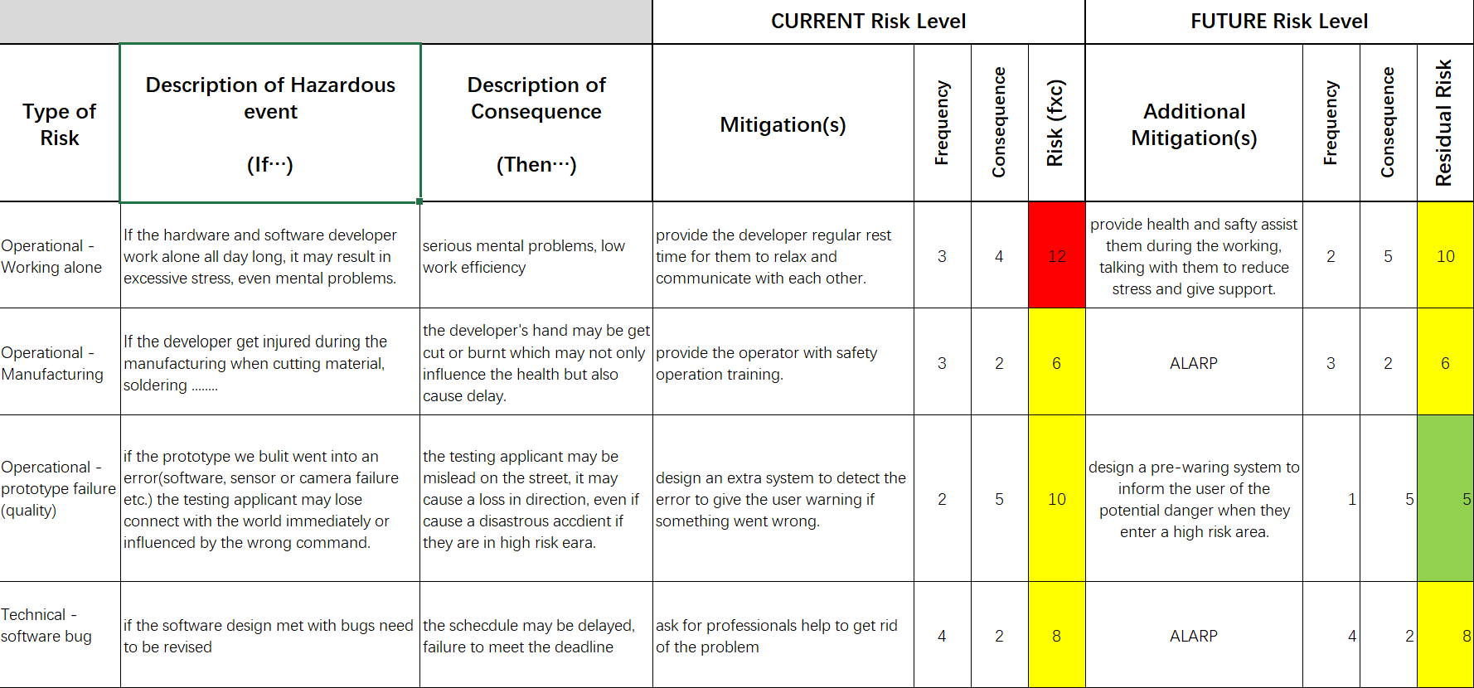
Risk assessment form
Notes:
Three types of different risks: operational—to people, technical–to the outcome of the project, project–to the management of the project.

Slide 30
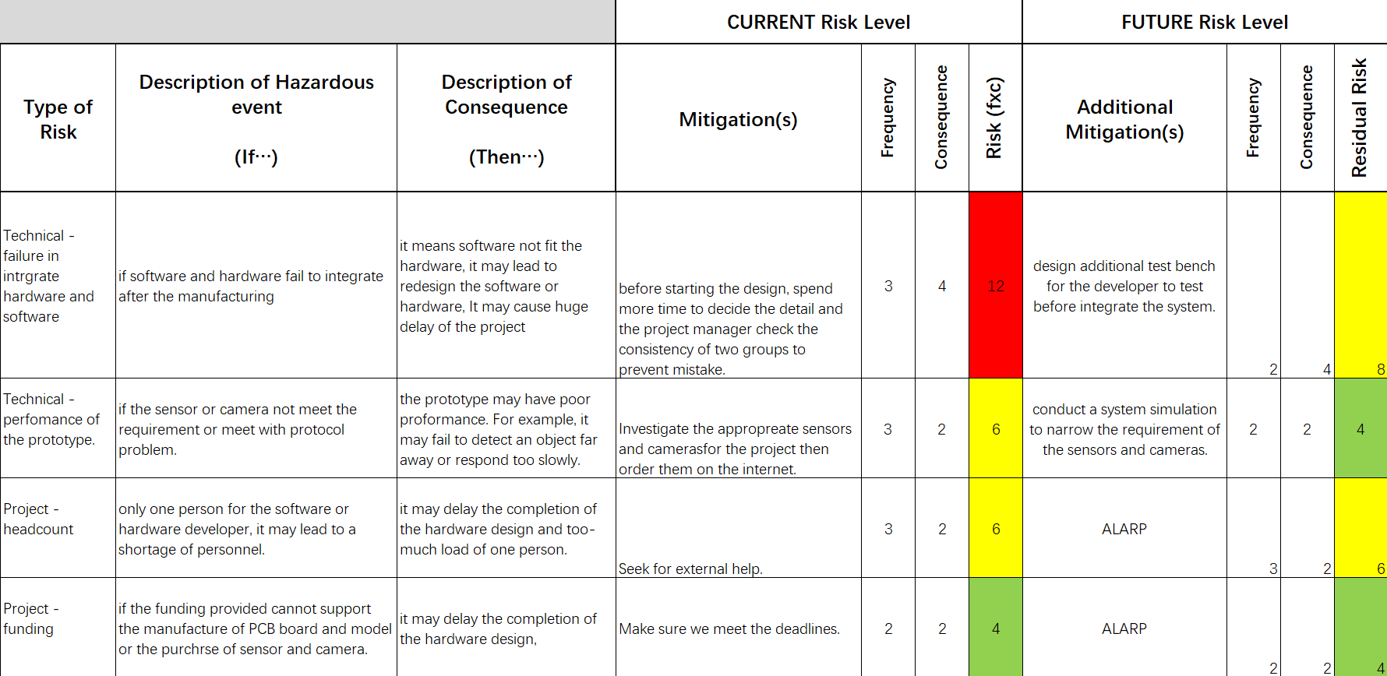
Risk assessment form

Slide 31
Findings and Prevention of the Risks
Working alone
Failure in integration
Highly likely to occur due to lack of developer.
Delay the hardware and software design process(critical path)
Additional health support and supervision to improve efficiency
Likely to occur because hardware and software design are in parallel.
Delay the integration process, even need to redesign the software/hardware.
Test bench for testing and support from hardware group (finish earlier).
Notes:
There are two essential risks that should be avoided during the project because it is in the critical path of our project timeline.
Working alone:
Failure in integration of software and hardware design:
Further prevention: one month flexible period. Even if the a delay has been occurred, there is a tolerance of a month.

Slide 32
07
Conclusion and Reflection

Slide 33
CONCLUSION
Improve the quality of life and independence of visually impaired individuals.
This technology will require careful planning, collaboration, and resource management.
Conducted a comprehensive risk assessment to identify potential roadblocks and challenges that could impact the success of this project.
REFLECTION
Communication: Weekly in person meetings with clear goals.
Workspaces: utilization of Github and shared google document.
Areas for improvements: Find a more comfortable environment for group meetings.

Slide 34
Thank You for listening

